Slide 1
Course Quality
For INT/HYB/WEB Courses
Version 1.1
Temple College
Brian St. Amour, Director eLearning
Christa Quigley, Associate Director

Slide 2
Topics in New Course
What is Course Quality?
Why is it important?
How to approach Course Quality
Guidelines & Practices
Resource Web Sites
Putting it into Practice
Final Thoughts

Slide 3
What is Course Quality?
Course quality is an essential consideration in the instructional design process
Quality can be an abstract concept.
  Two different people may look at the same course, and one may say it is high quality and the other may not.
To make the idea of quality more concrete and measurable across courses, institutions should select a set of criteria that they will use to evaluate their courses.
  Select an existing set of criteria or create their own; either way, having set quality standards offers several important and valuable benefits.

Slide 4
Why is Course Quality Important?
Many colleges and universities see the importance of online course quality to foster student success and retention
Need to be complaint with SACSCOC and The Texas Coordinating board requirements - re-accreditation will impact this area

Slide 5

How to Approach Course Quality?
Starting for Fall semester we will kick-off an initiative to consciously take the first steps in the journey of online course quality as part of our institution's student success initiative.
This initiative will look at course design best practices including course readiness checklists, design and navigation considerations, as well as compliance with ADA regulations.
Be mindful of the student experience in terms of layout and navigation
Be mindful of checklists
Be mindful of rubrics

Slide 6

Guidelines & Practices
Be mindful of the student experience in terms of course design and layout
Be mindful of course navigation in terms of student’s perspective … if you confuse them you lose them!
  Where do I go?
  How do I get started?
  What are the components of my course?

Slide 7



Guidelines & Practices
Focus on a well designed, easy to navigate student experience
  Intuitive layout
  Consistency in modules
  Intuitive Navigation
  Clear directions/instructions
  Be mindful of checklists
  Be mindful of rubrics

Slide 8
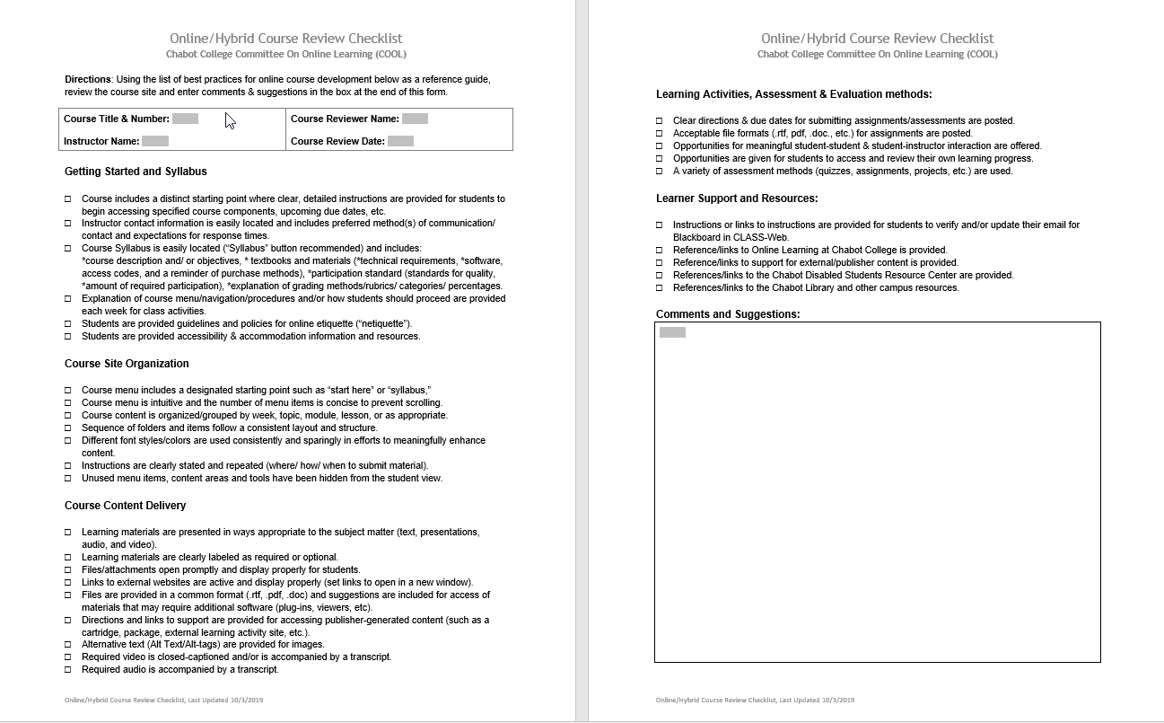
Guidelines & Practices
Checklists for course readiness each semester

Slide 9
Guidelines & Practices
Video Recording & Captioning
All videos must be closed captioned to be in ADA compliance
  VidGrid Software, currently being piloted by a few faculty with positive feedback (Health Professions uses VoiceThread which is specific for medical terminology)
  Software client which installs on any pc
  Records pc screen or faculty, the recording is then machine-captioned through an automated service with 85% plus accuracy, faculty can easily make edits or corrections.
  www.vidgrid.com

Slide 10
Guidelines & Practices
Publisher Integrations
Inform eLearning that you are using a publisher integration – often eLearning will need to add you course(s) to a specific plugin list within D2L each semester to allow a pathway to the publisher integration site. Although are able to see previous semester integrations and use that as a basis for new semesters, however it is a good practice to remind us, especially if you change publishers.
Be on a first name basis with your account rep and technical account rep – if you have questions, problems or issues it is always a good practice to have your sales rep and technical account reps’ phone numbers and email contacts handy in order to respond to issues quickly and seamlessly.
When first setting up an integration conduct a web screen share meeting with your rep and record the session for your records – this will greatly reduce the time spent to set up an integration and ensure that it is set up correctly, you can then view the recording should you need to remind yourself how to do it again in a future semester. Often your rep will schedule this for you and all you need to do is click on the link to enter the meeting
Provide clear instructions in a news item and/or content module with easy to understand instructions/directions on how to set up the integration – publishers often can provide these materials however you should create a module or place the information in your Syllabus & Policies module with an intuitive name such as Setting up your Cengage (or other) Integration. Keep in mind that they directions can become out of date and should be reviewed periodically for accuracy and being up-to-date.
Create a Discussion forum(s) entitled “Problems or Issues with your Publisher Integration – Post Here” and locate it at the top of Discussions – this will provide students with a way to alert you if they have problems or issues, plus it makes it easier for you to manage issues.
Be prepared to assist students with resolving issues or coordinate problem resolution with your publisher rep contacts – avoid or minimize sending students to 1 800 support numbers, it is better to alert you rep so that they can be aware of issues or trends, odds are that if one student is experiencing an issue it may also be affecting other students. In cases when a student must be directed to 800 support please keep in contact with the student and engage your rep.

Slide 11
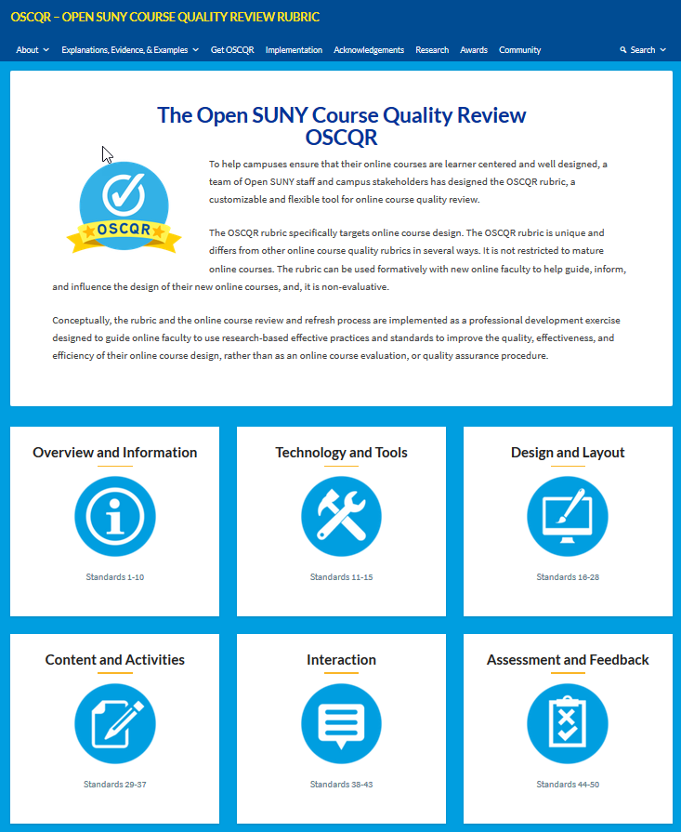
Putting It into Practice
Step 1: Visit the SUNY website to learn about the elements of course quality at https://oscqr.suny.edu/
  The OLC Online Course Quality framework provides a process, tools, and resources to systematically review, refresh, and continuously improve online courses.
  The aim of the Open SUNY Course Quality Review (OSCQR) Rubric and Process is to support continuous improvements to the quality and accessibility of online courses
Review the 6 categories to learn more
  Each category has a page which lists elements,
  click on each line to access additional information and a mini video on that subject

Slide 12
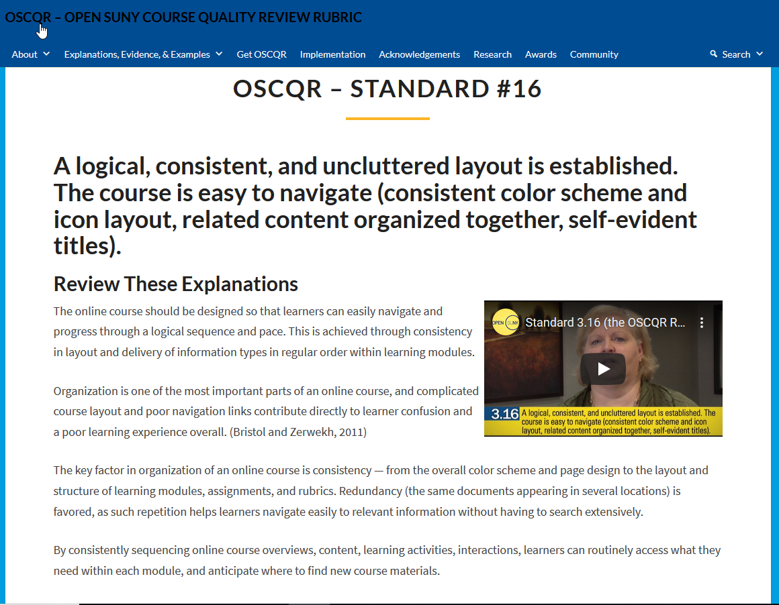
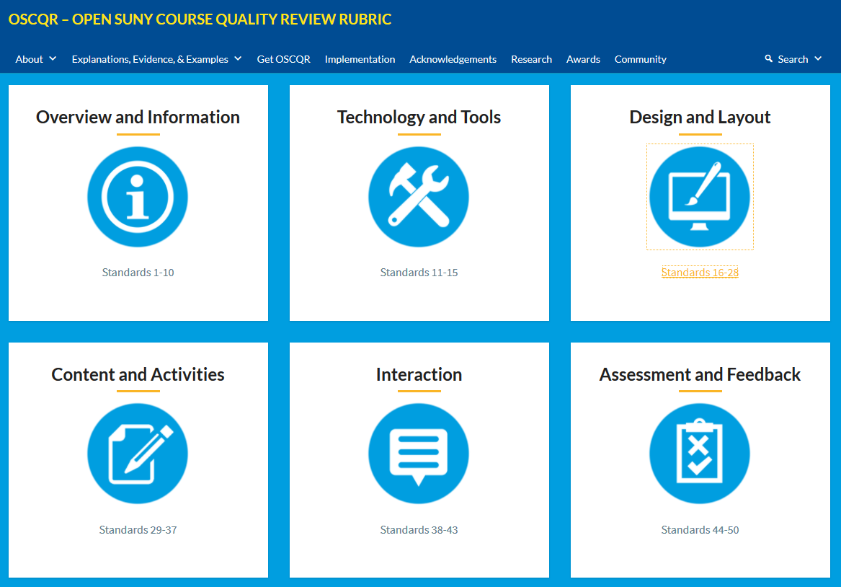
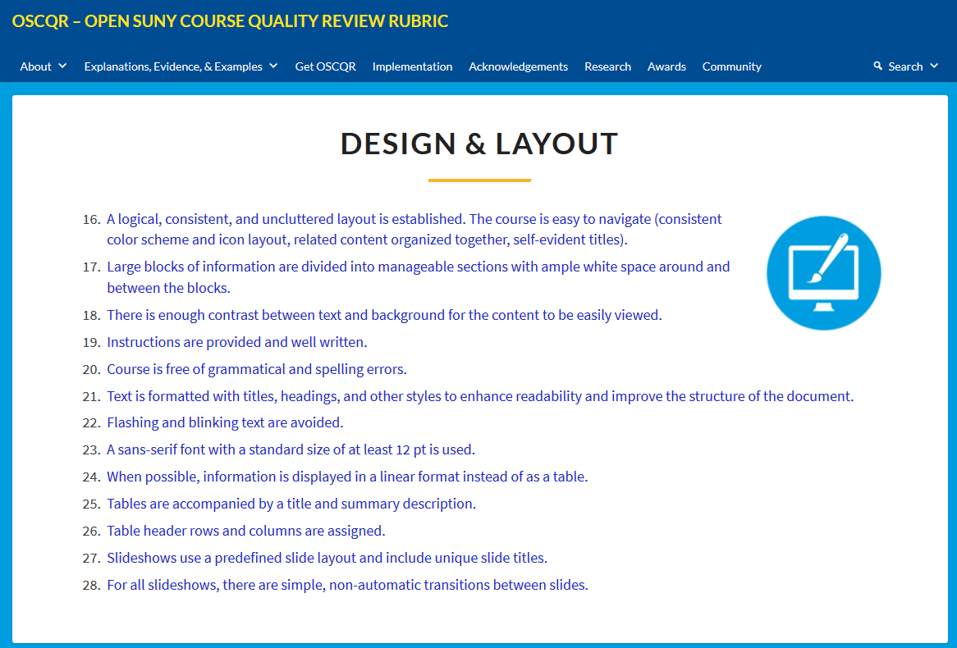
Putting It into Practice
Example of SUNY course quality training module

Slide 13
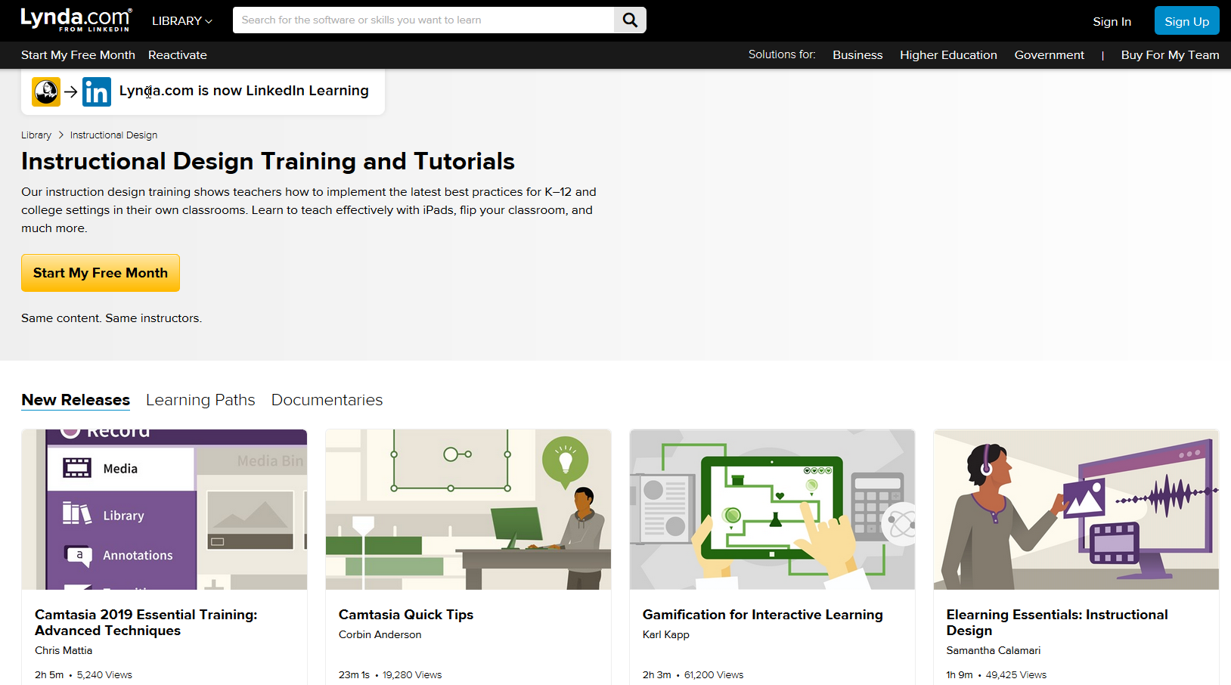
Putting It into Practice
There are many eLearning instructional design modules on the Lynda.com from LinkedIn website which include a standardized Checklist at https://www.lynda.com/Instructional-Design-training-tutorials/1796-0.html

Slide 14
Putting It into Practice
Step 2: Conduct a course review against the “essentials” checklist
  Create/Update a “Welcome” News Item or “Getting Started in the course” message
  Verify Syllabus each semester for information accuracy
  Verify/Update Textbook information
  Provide Instructions for publisher integrations
  Creating/Updating a course gradebook to be available on day one of the course
  Verify/Update Course Calendar & Due Dates for each semester
  Verify content for accuracy and ensure it is up to date
  Verify activation & release of content for student access
  Verify that web links are still active/working
  Use appropriate font size and type face
  Avoid use of distracting colors or flashing text
  “Chuck” information into smaller bites to reduce clutter

Slide 15


Putting It into Practice
Chunking content to avoid information overload
Chunking refers to an approach for making more efficient use of short-term memory by grouping information
Chunking breaks up long strings of information into units or chunks. The resulting chunks are easier to commit to memory than a longer uninterrupted string of information
Example – a 10 page syllabus is overwhelming … break out information into separate links … remove unnecessary information … be concise and succinct
For more information visit http://thepeakperformancecenter.com/educational-learning/thinking/chunking/chunking-as-a-learning-strategy/

Slide 16
Putting It into Practice
Step 3: Collaborate with your Peers
  Form teams in your departments and collaborate on course design and layout
  Consider using a standard course template and modify “to make it you own”
  Ask eLearning to create a course development shell to provide you with a place to build out your course(s)
  Share best practices with peers.

Slide 17
Final Thoughts
Faculty will continue to have academic freedom in their courses
The quality imitative is not limited to online courses – it can be applied to
  Web-Enhanced
  Hybrid
  Face-2-Face
Goal is to foster student success initiative by providing a high quality course experience in terms of layout and design which contributes to a more positive and successful learning experience

